Slide 1


Monitoring Workers' stress levels
Shend Osmanaj: https://www.linkedin.com/in/shendosmanaj/
Lorenzo Leschiera: https://www.linkedin.com/in/lorenzo-leschiera-55a706156/
Matteo Rizza: https://www.linkedin.com/in/matteo-rizza/

Slide 2
Motivations
Direct costs:
Indirect costs:
Health costs for the injured
Legal costs
Insurance costs
Costs for damage
Lost production for interruptions caused by accidents
Workforce Extraordinary costs and Substitutions
Cost of activities investigation, compiling records and reports with the supervisory authorities
Damage Image

Slide 3
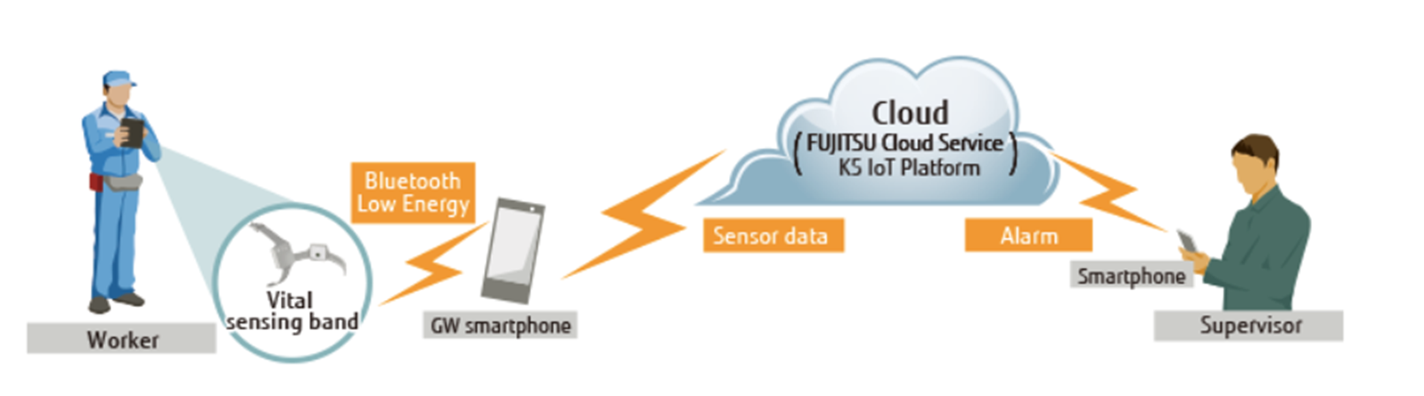




Our proposal
Our idea is to monitor the heartbeat of workers through polar optical sensors, save the acquired data in real time to analyze them and, in the event of anomalies or emergencies, send an alarm signal to the workplace supervisor so as to act promptly.

Slide 4
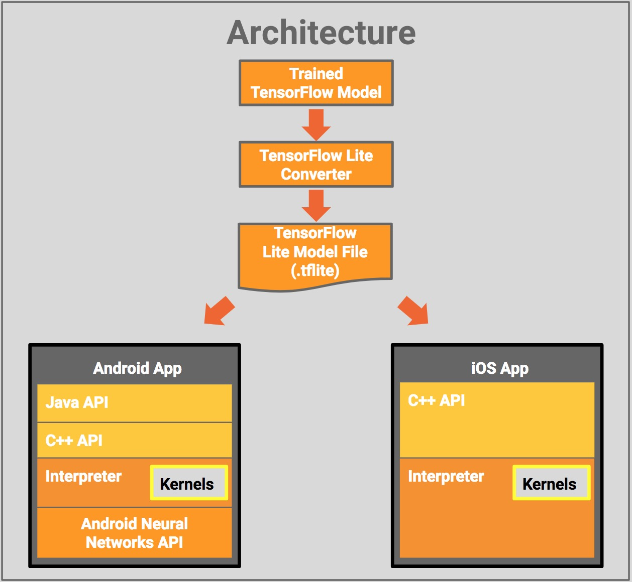
TensorFlow Lite is Tensorflow’s lightweight solution created by Google.
It is used for creating machine learning applications such as neural networks in mobile and IoT devices. It was created by Google.

Slide 5
Creating the model
Get the data from the dataset and format them for better performance of the algorithm.
Create the tensorflow placeholders so we can feed our training examples x and y into optimizer during the training process. We also create W and b which will be optimized through gradient descent optimizer.
Declare hypothesis, cost function, optimizer and global variables initializer.
Do the training process inside a tensorflow session and save the model.

Slide 6
Logistic Regression
A learning algorithm used in supervised learning problems when the output is either zero or one.
Categorizes data into discrete classes by learning the relationship from a given set of labeled data.
Its goal is to minimize the error between its predictions and training data.
The hypothesis is the Sigmoid function which has values from zero to one.
y = sigmoid(w*x + b) where sigmoid(z) = 1/(1 + e^-z)
w is the weight matrix and b is the bias of the model.
To find the optimal values for w and b, for which the cost function J is minimum.
The cost function will then be optimized using Gradient Descent.

Slide 7
Input: a matrix x with m rows and 2 columns which are the values of Heart Rate and ECG read by Polar Heart Rate monitor.
Output: Prediction y,that gives value 0(not-stressed) or 1 (stressed), based from the input.
After creating the model, we save it.
For using our model in mobile app we need to use the converter to convert the model in a .tflite format.
After finishing the conversion, we get the .tflite file and use it in Android Studio for integration on the mobil app.

Slide 8
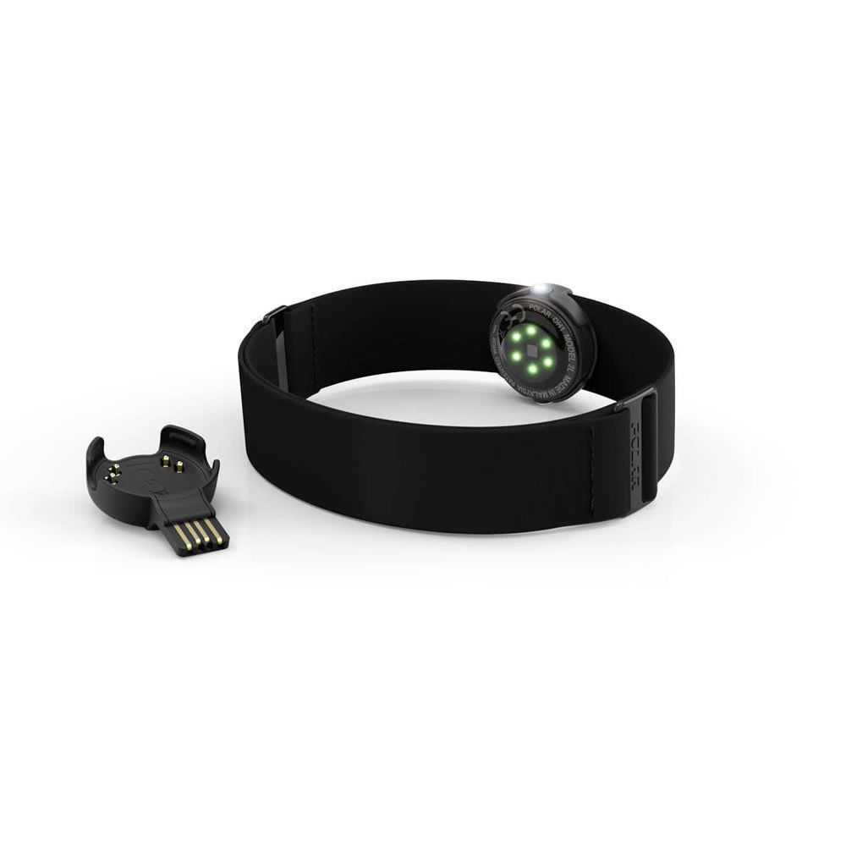
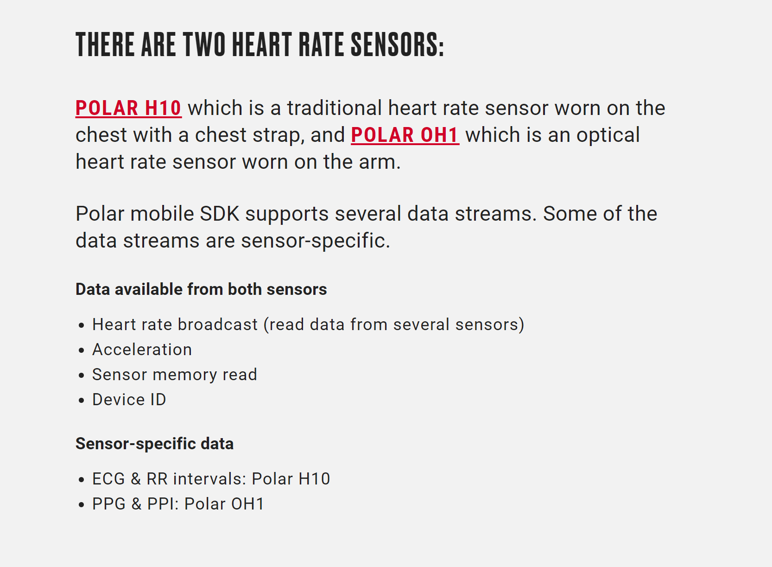
Polar OH1 Heart Rate Sensor

Slide 9
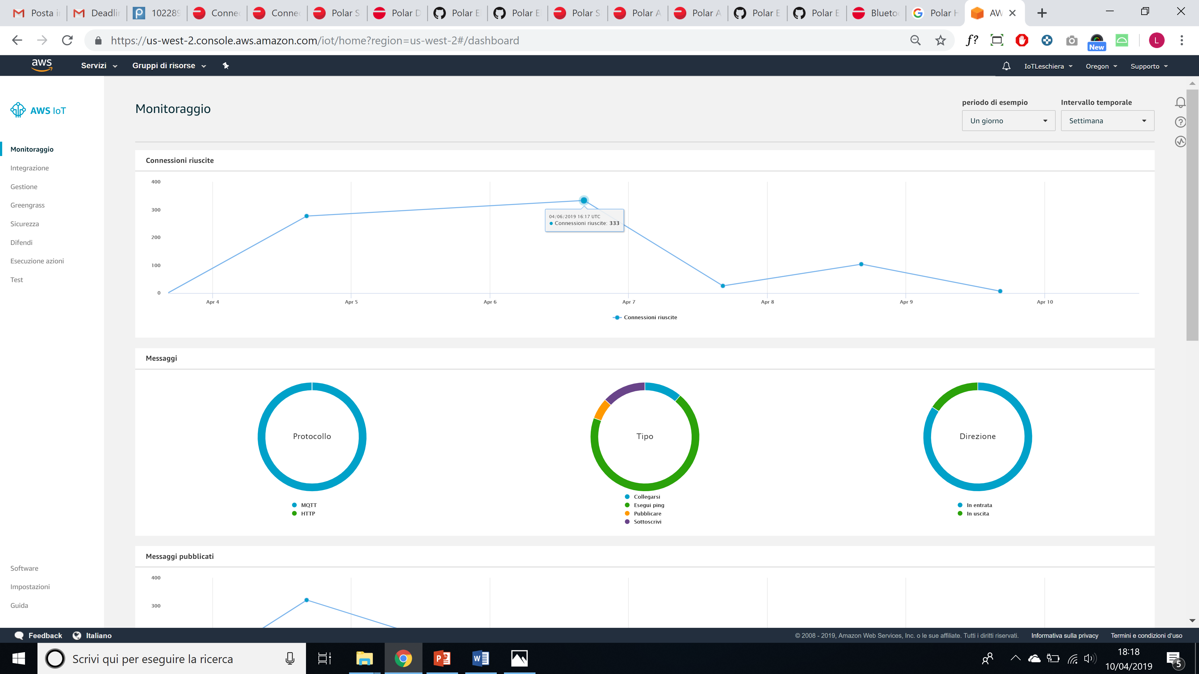

AWSIoT

Slide 10
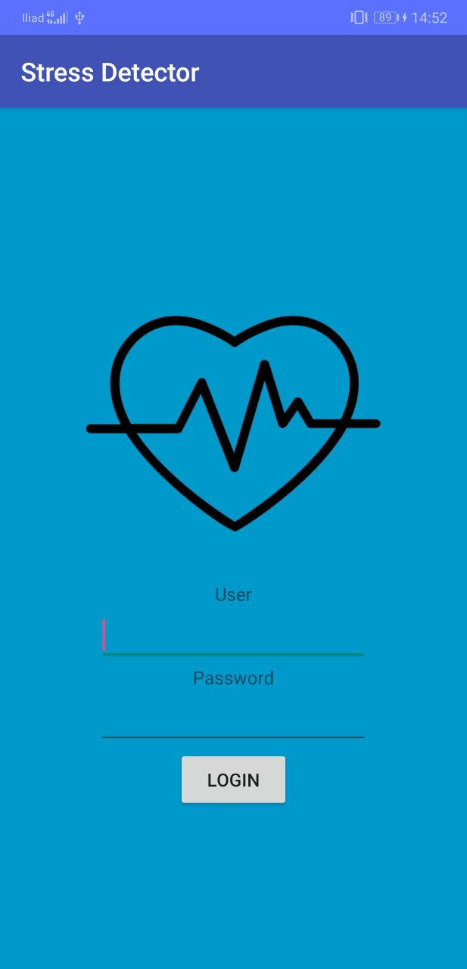
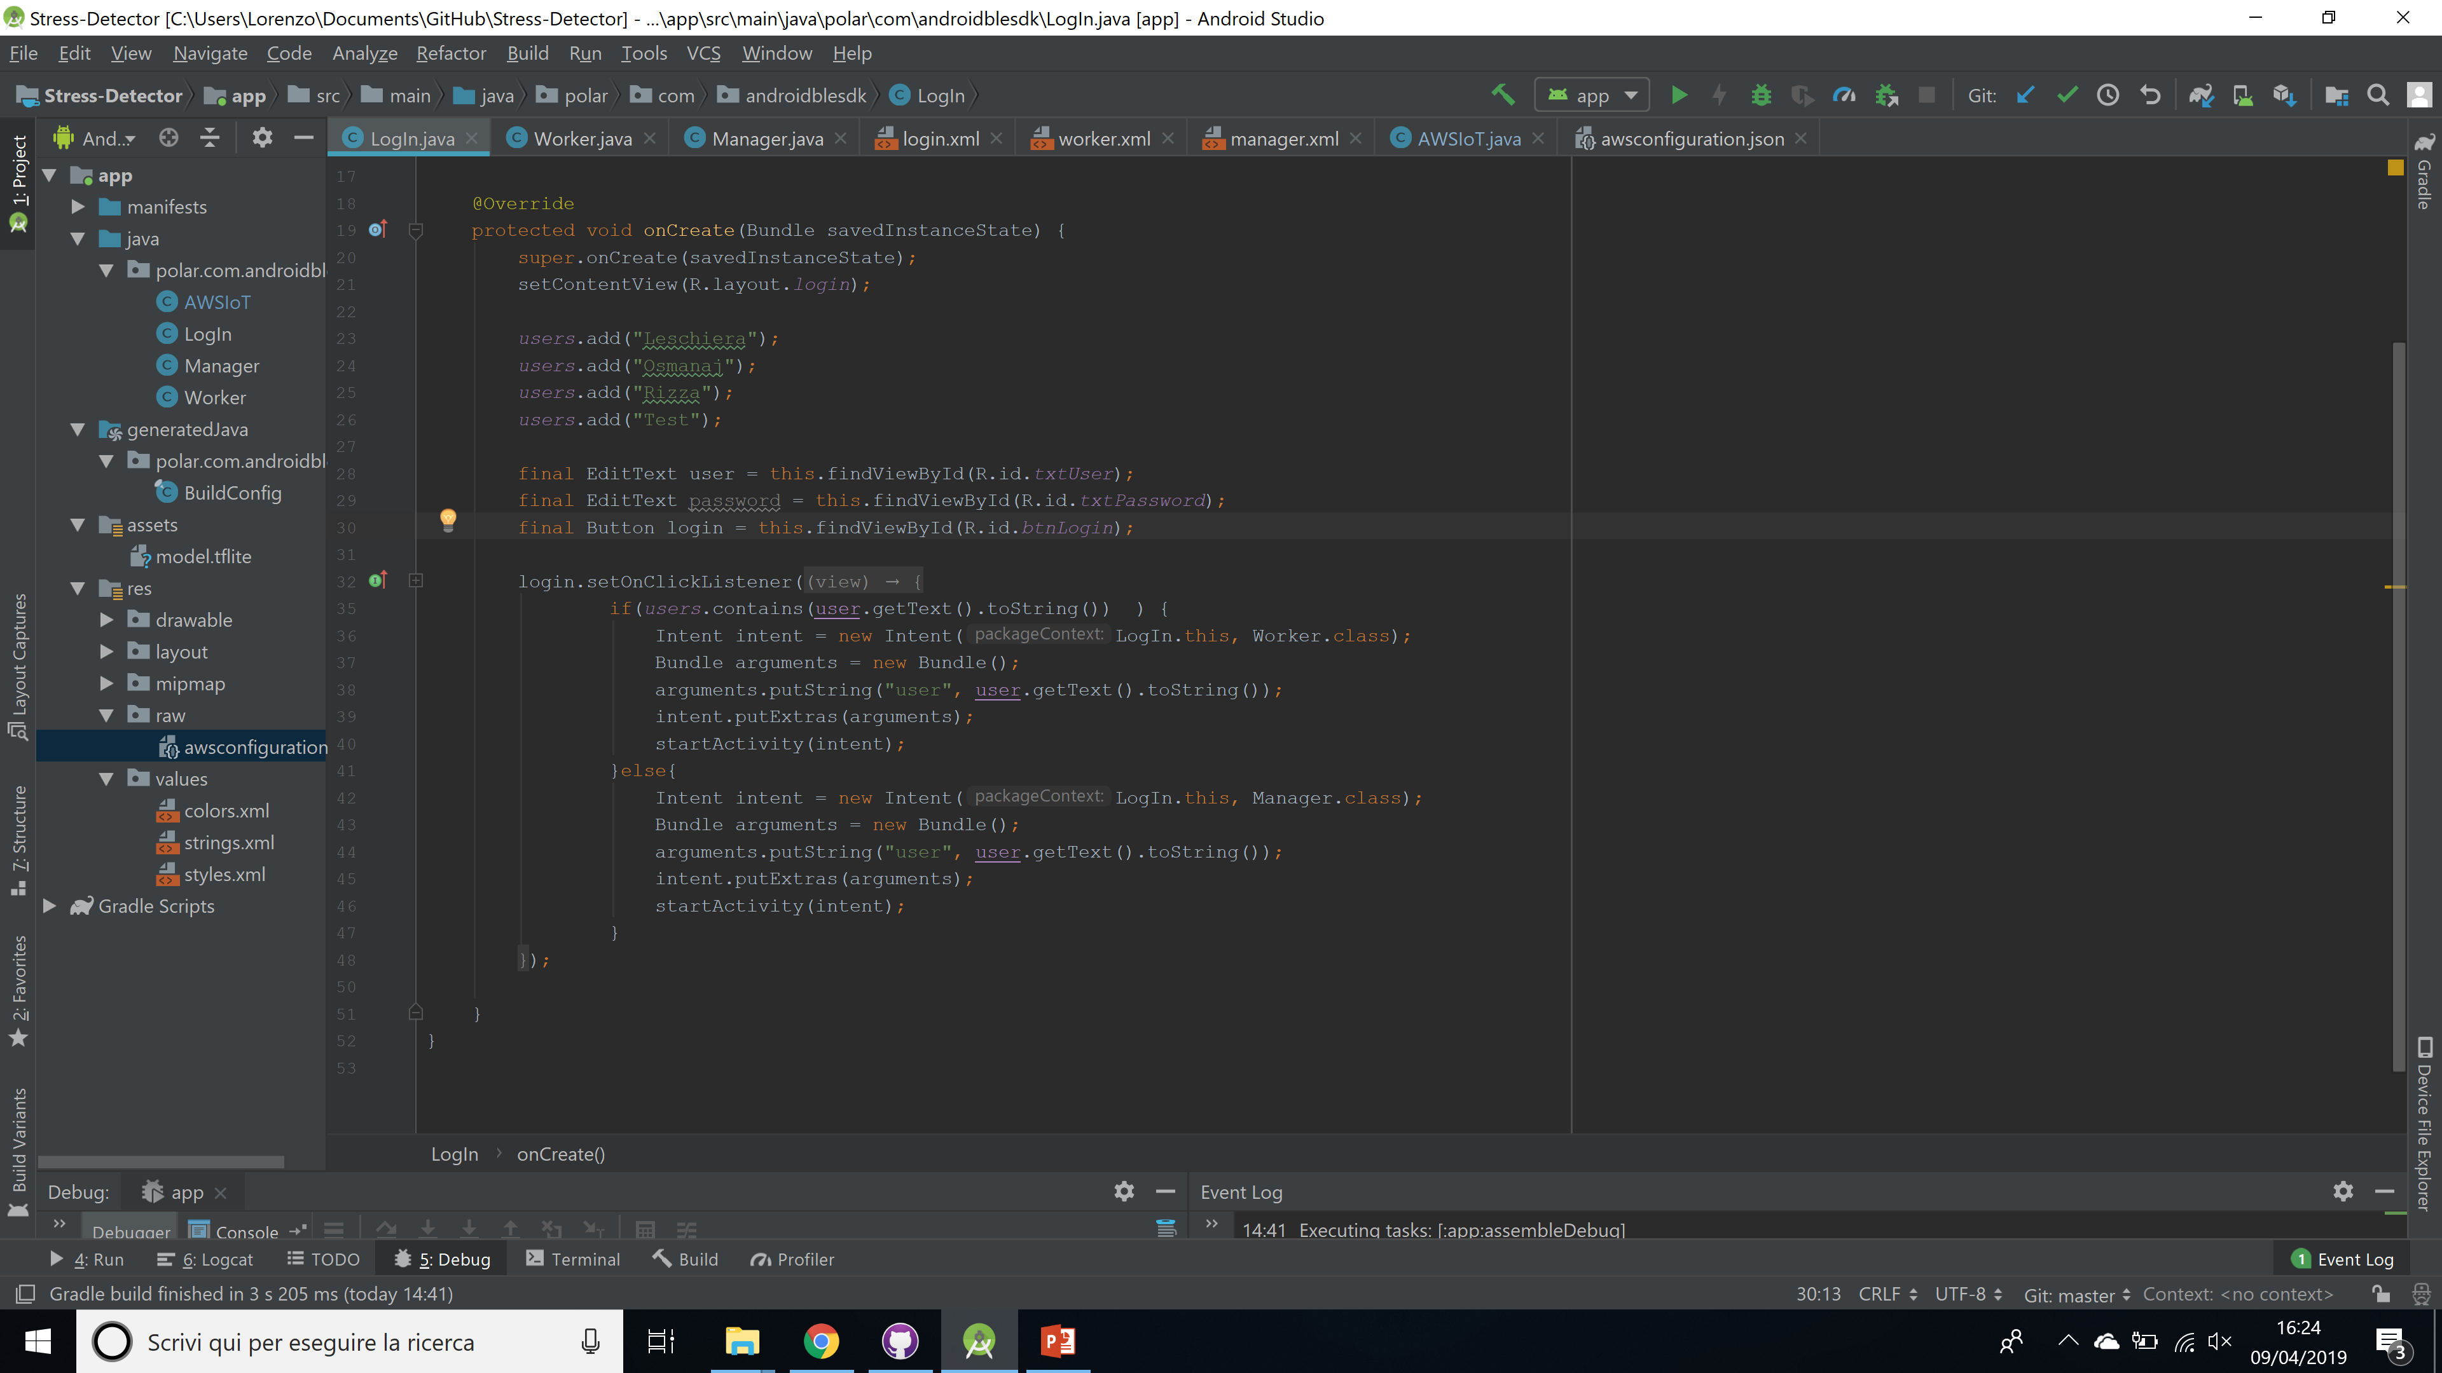
LogIn

Slide 11
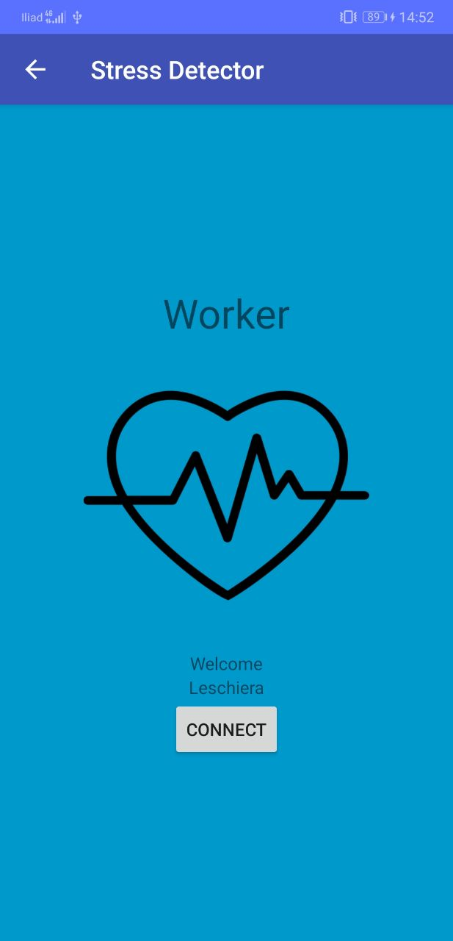

Publish

Slide 12
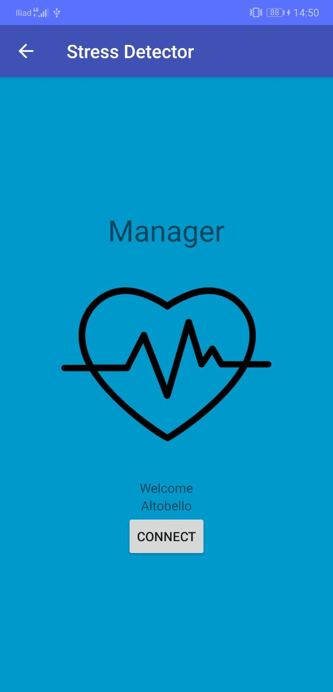
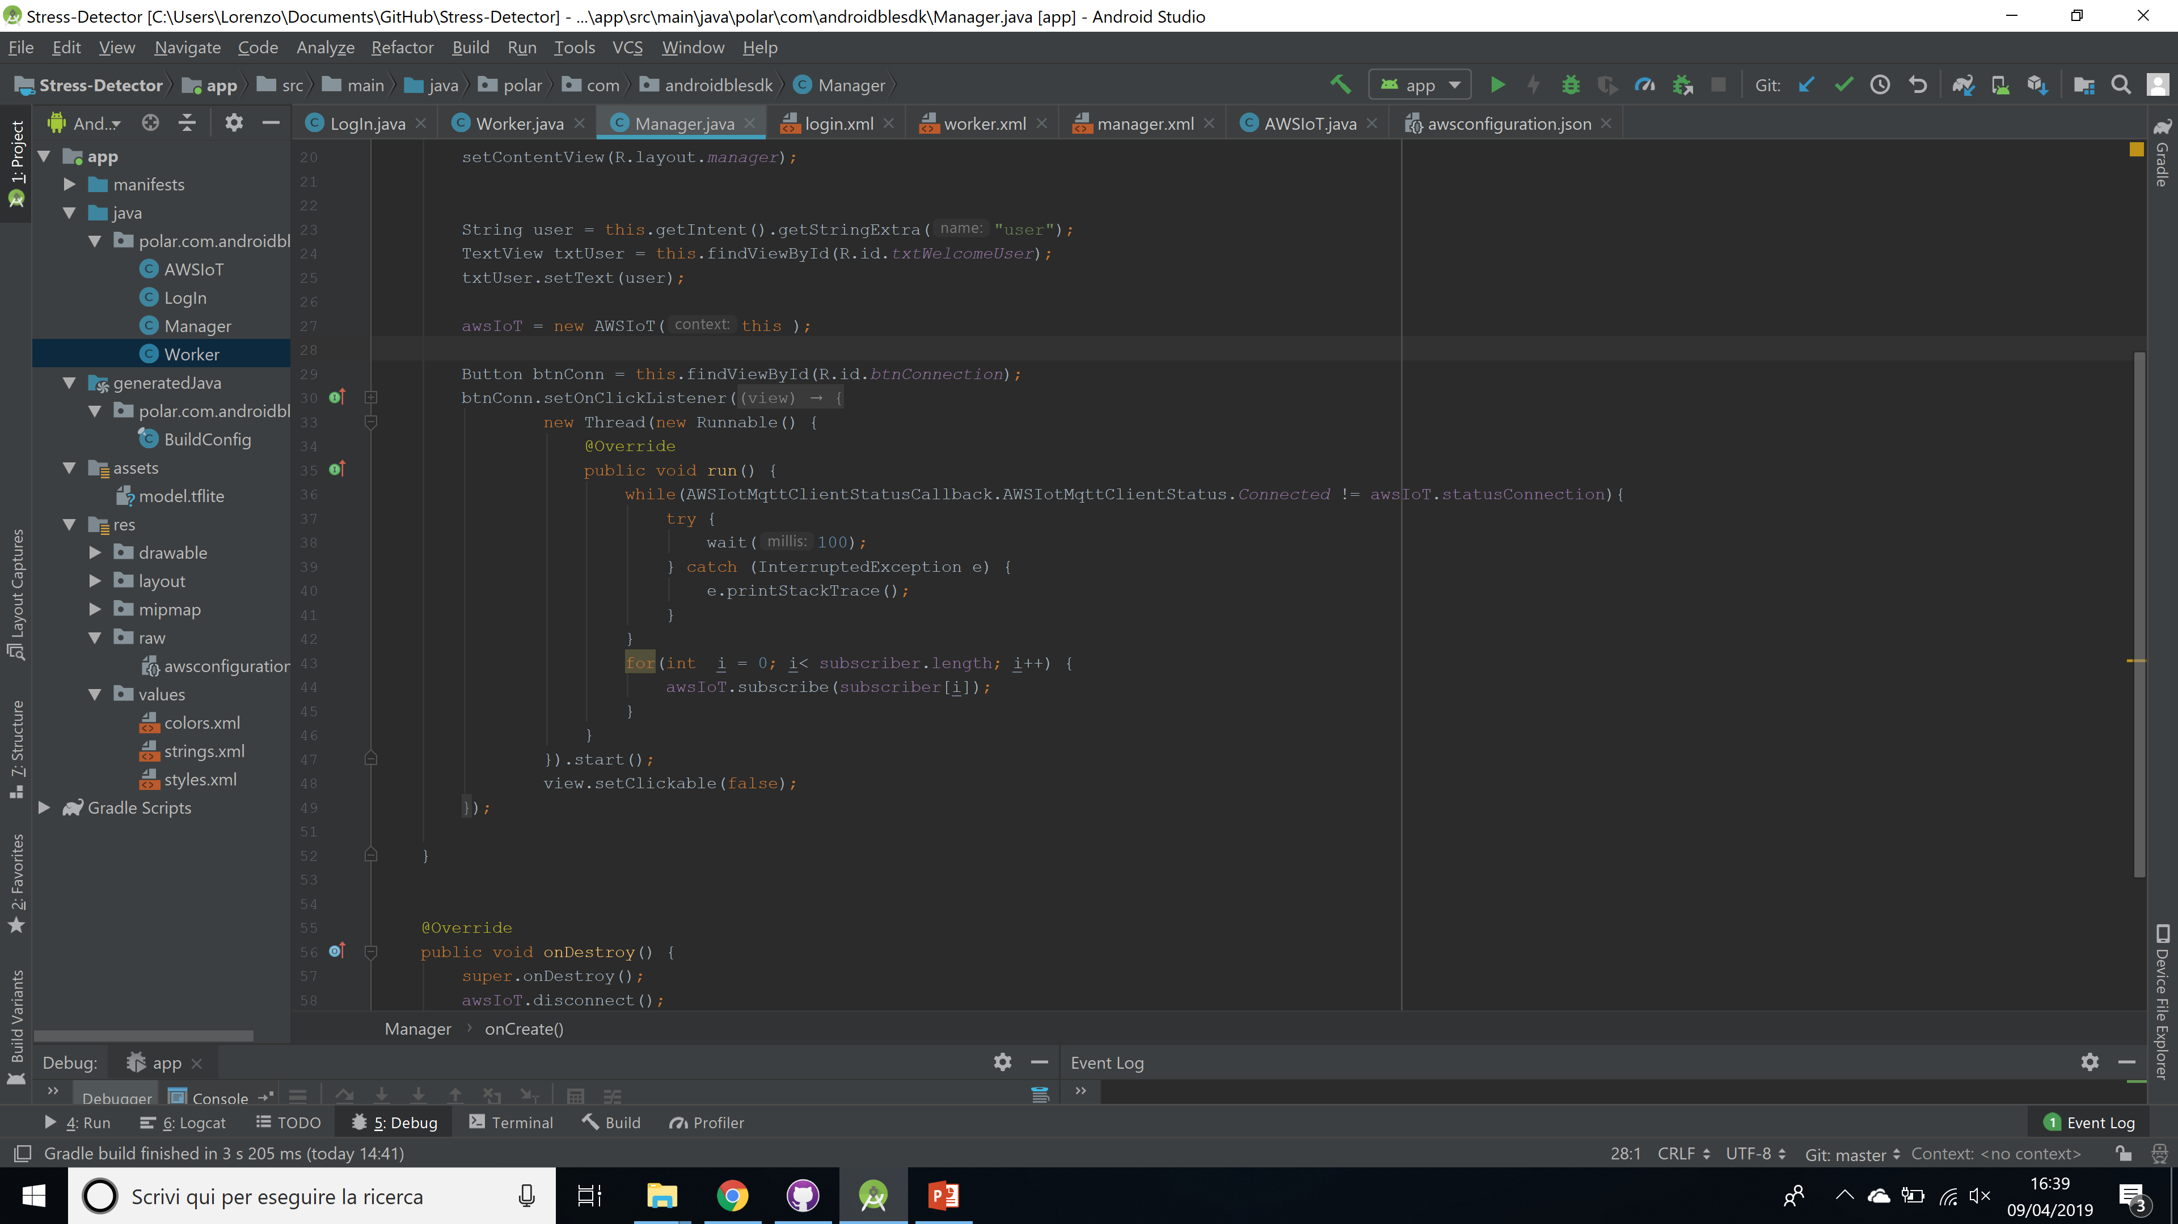
Subscribe

Slide 13
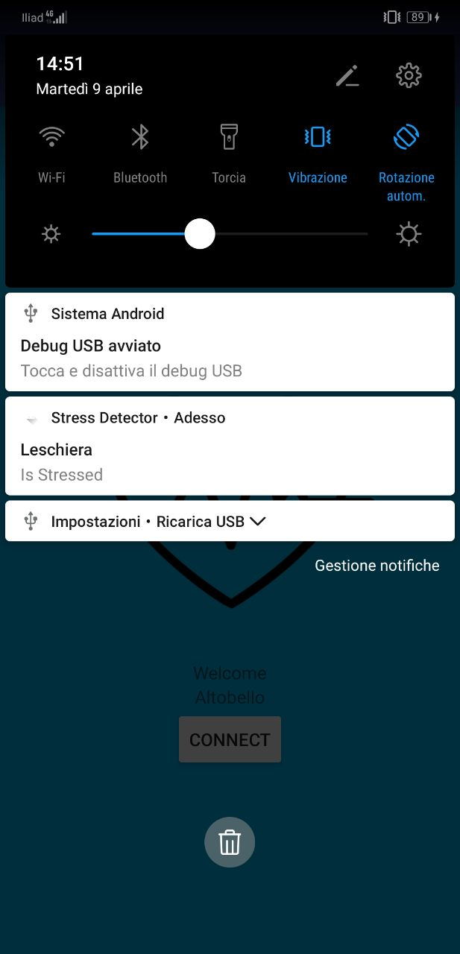
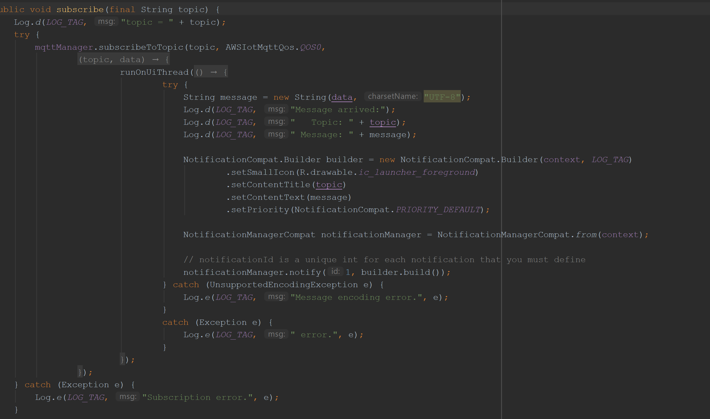
Notification of Stress

Slide 14
Graphite is a tool that does two things:
storing numeric time-series data and rendering graphs of this data on demand.
Graphite components:
carbon
whisper
graphite webapp

Slide 15
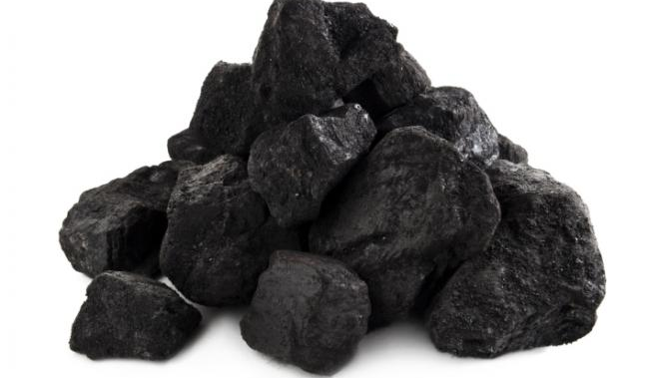
Carbon
Several Carbon daemons can be used in a single Graphite configuration:
carbon-cache
carbon-relay
carbon-aggregator

Slide 16
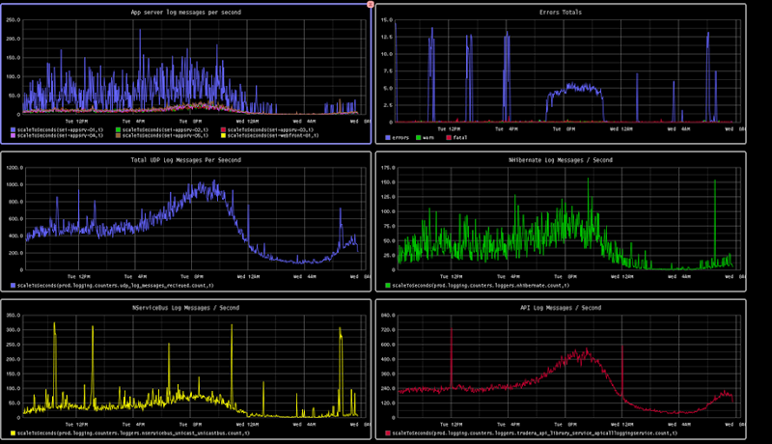
Graphite web application
It is the most visible and dynamic component of a Graphite.
This is where you can design graphs that plot your data.

Slide 17


Thanks for the attention
Useful links:
https://github.com/leschiera/Stress-Detector
https://www.hackster.io/149963/monitoring-workers-stress-levels-87f46a

